Slide 1
Recitation section 11
11/4/2016 and 11/7/2016

Slide 2
Problem 1
x(t) and y(t) are signals with Nyquist rates, and respectively
Determine the Nyquist rate for each of the following signals:
a)
b)

Slide 3
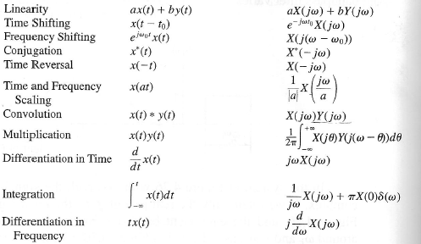
Using Properties of FT

Slide 4
Hint for problem solving on Homework

Slide 5
Problem 2
Consider a signal x(t), which undergoes impulse train sampling to generate , where
a) If the signal was sampled at a sampling frequency of 75π, does aliasing occur?
b) For a sampling frequency of 250π, determine the range of values for cut-off frequency of a low pass filter that would ensure that x(t) is recovered from
p(t)
x(t)
x
H(jω)
y(t)

Slide 6
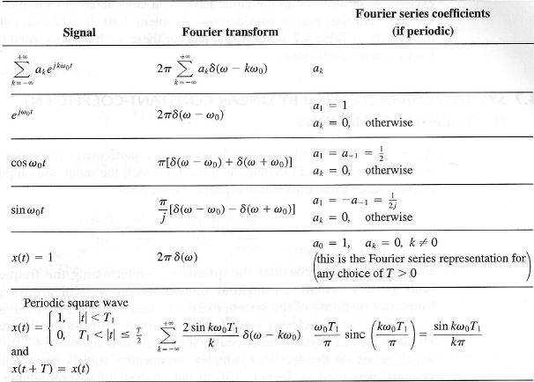
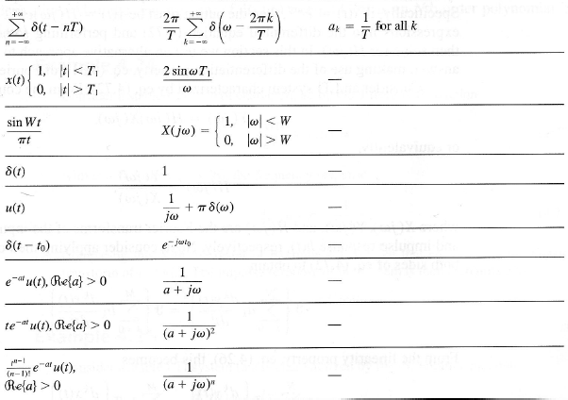
Fourier Transform Pairs

Slide 7
Problem 3
A signal x(t) with fourier transform X(jw) undergoes impulse train sampling to generate:
Where T = . Given that X(jw) = 0 for |w|>15000 , can x(t) be recovered from ?

